Slide 1

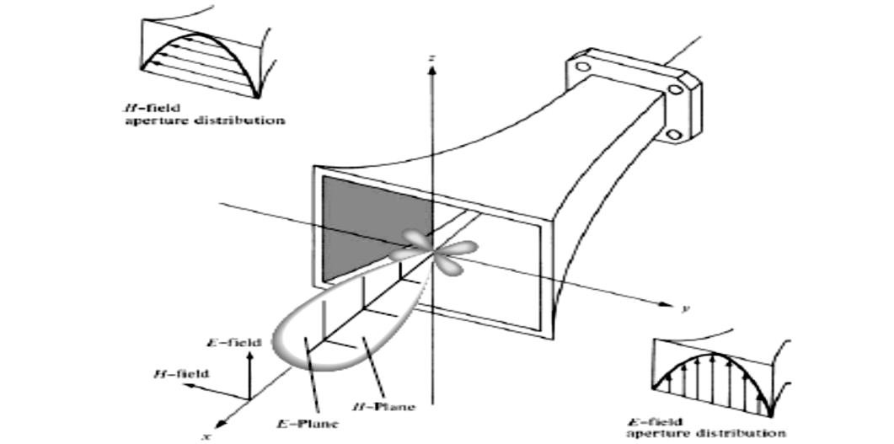
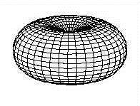
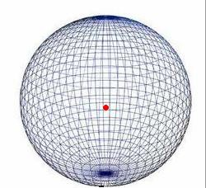
Dept. of Communication Engineering College of Engineering- University of Diyala Lecture No.: 3 part(2)
3rd year Class
Antenna Theory and Design Lec. Jinan N. Shehab
2-1-1 Antenna Pattern Types
Isotropic Pattern :- An isotropic radiator is defined as “a hypothetical lossless antenna having equal radiation in all directions.” Although it is ideal and not physically realizable, it is often taken as a reference for expressing the directive properties of actual antennas.
Directional Pattern:- is one “having the property of radiating or receiving electromagnetic waves more effectively in some directions than in others. This term is usually applied to an antenna whose maximum directivity is significantly greater than that
of a half-wave dipole.”
Fan-Beam Antenna:- A fan-beam antenna is a directional antenna producing a main beam having a narrow beamwidth in one dimension and a wider beamwidth in the other dimension.
Pencil beam antenna:- is applied ahighly directive antenna pattern usually the beam is circular symmetric about the direction of the peak intensity
Omnidirectional Pattern:- is most popular in communications and broad cast applications. is nondirectional in the azimuth plane [θ = π/2] and directional in the elevation plane [ φ = constant]. This type of a pattern is designated as omnidirectional, and it is defined as one “having an essentially nondirectional pattern in a given plane (in this case in azimuth) and a directional pattern in any orthogonal plane (in this case in elevation).” An omnidirectional patternis thena special type of a directional pattern.
  Omnidirectional B) Isotropic

Slide 2
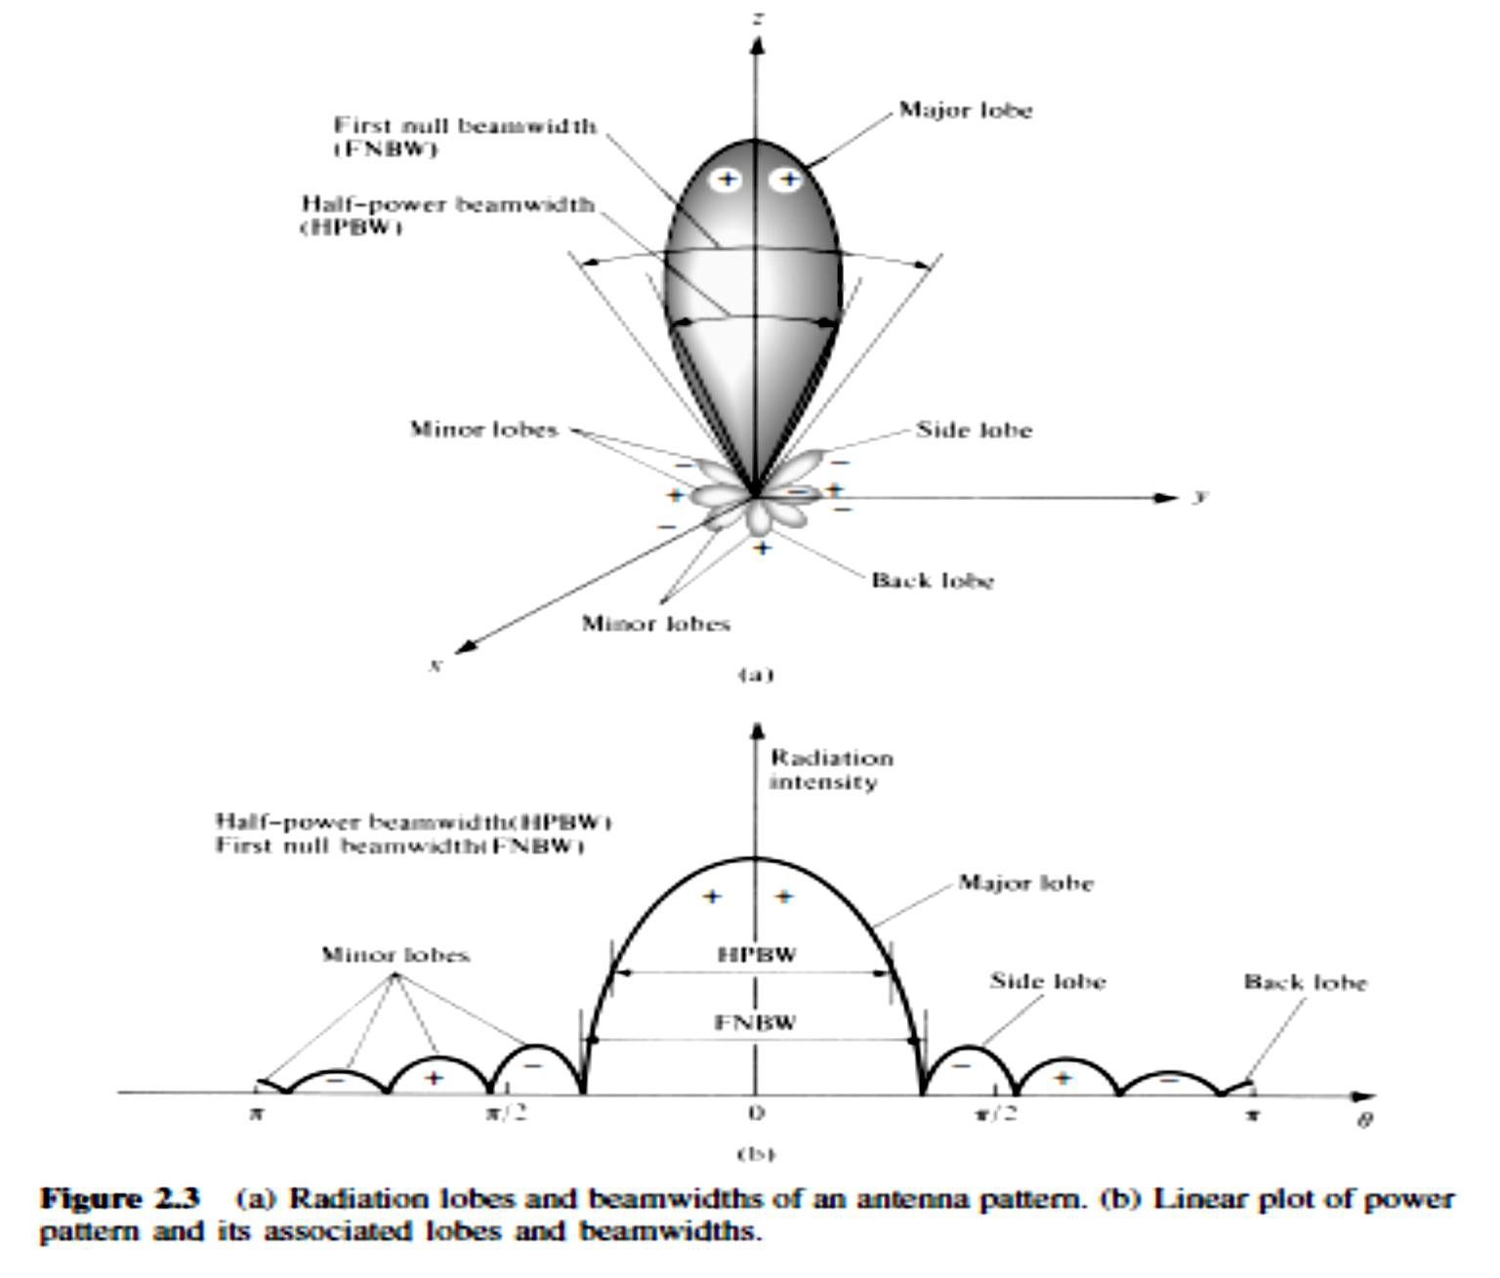
Dept. of Communication Engineering College of Engineering- University of Diyala Lecture No.: 3 part(2)
3rd year Class
Antenna Theory and Design Lec. Jinan N. Shehab
2-1-2 Radiation Pattern Lobes:-
A radiation lobe is a “portion of the radiation pattern bounded by regions of relatively weak radiation intensity.” Figure demonstrates a symmetrical three dimensional polar pattern with a number of radiation lobes. Some are of greater radiation intensity than others, but all are classified as lobes.
❖ Main Lobe (major lobe, main beam) - radiation lobe in the direction of maximum radiation.
❖ Minor Lobe: - any radiation lobe other than the main lobe such as:-
Side Lobe: - a radiation lobe in any direction other than the direction of intended radiation.
Back Lob: - the radiation lobe opposite to the main lobe.
  Beamwidth
The beamwidth is used as a trade-off between it and the side lobe level; that is, as the beamwidth decreases, the side lobe increases and vice versa.
The beamwidth of the antenna is also used to describe the resolution capabilities of the
antenna to distinguish between two adjacent radiating sources or radar targets.
1- Half-Power Beamwidth (HPBW) - the angular width of the main beam at the half- power points.
^{HPBW=|𝜽}𝑯�𝒍��𝒕^{− 𝜽}𝑯�𝒓���𝒕|

Slide 3
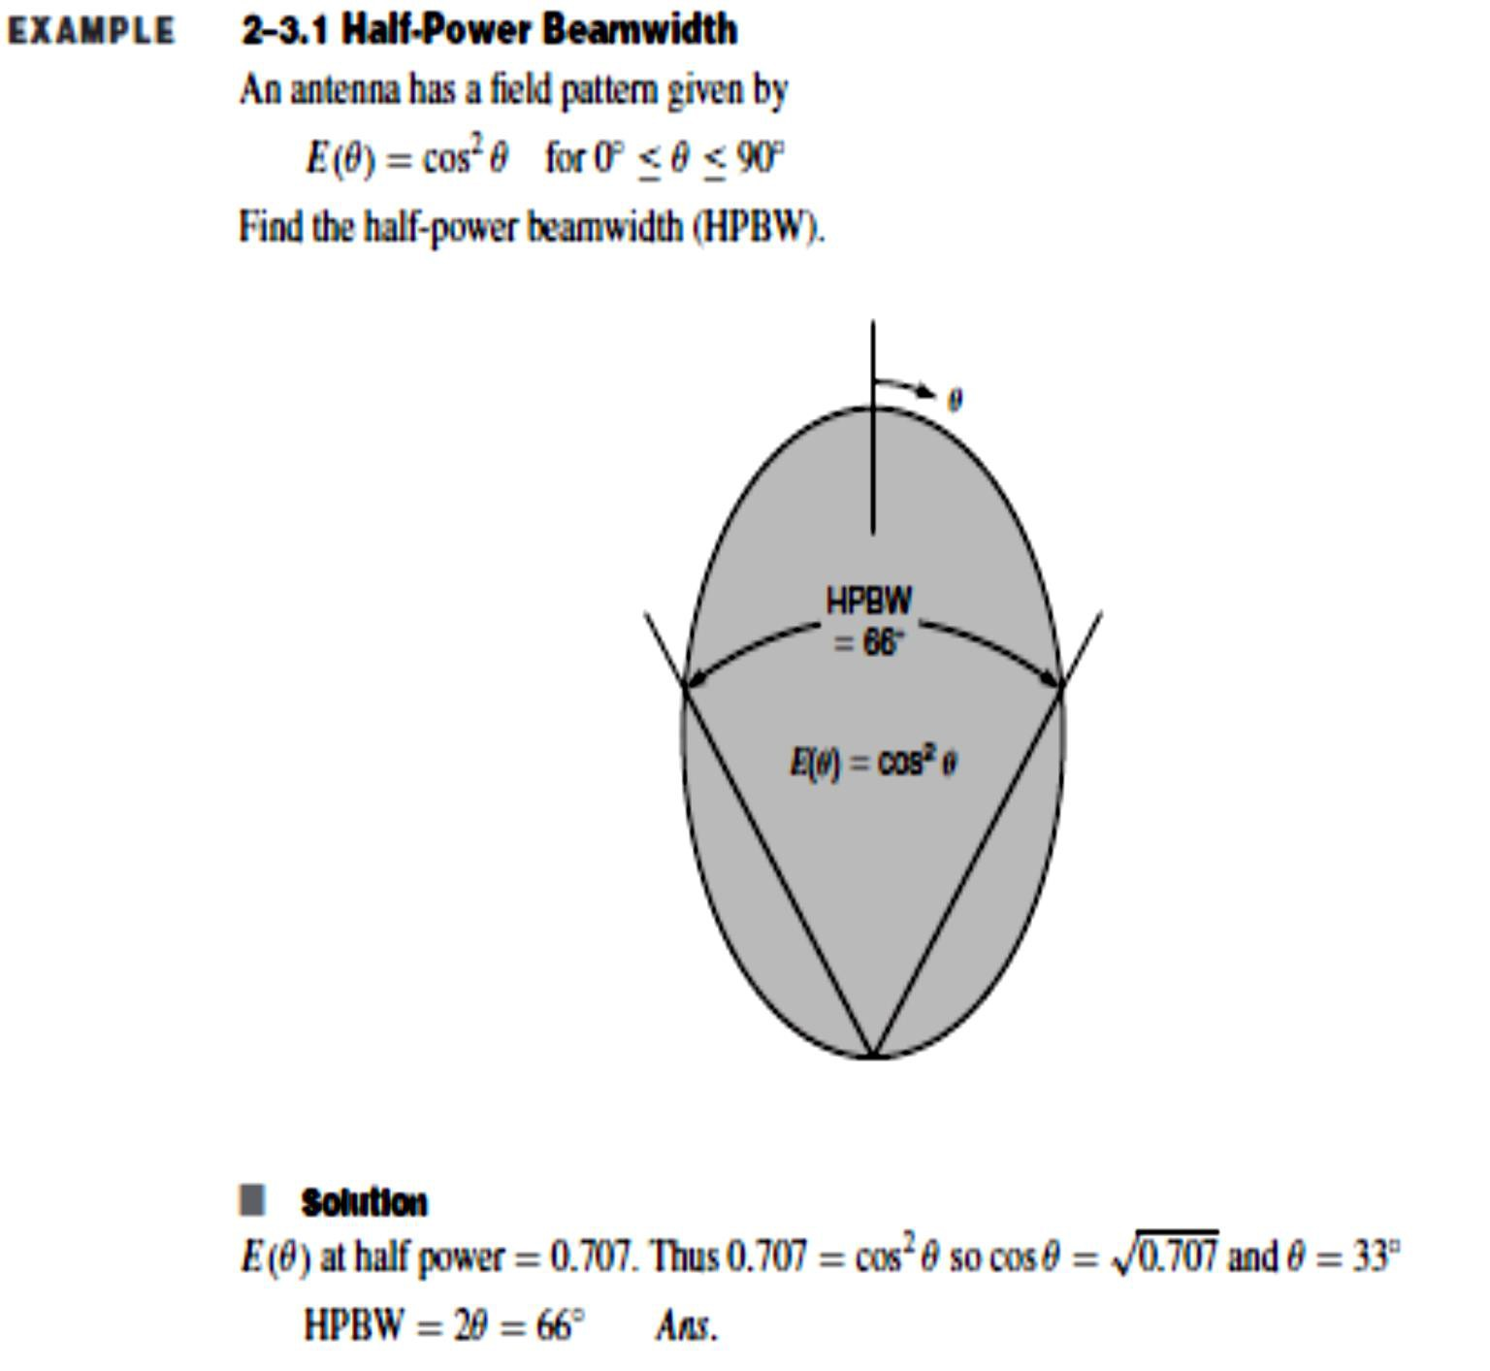
Dept. of Communication Engineering College of Engineering- University of Diyala Lecture No.: 3 part(2)
3rd year Class
Antenna Theory and Design Lec. Jinan N. Shehab
For example in the case of the ideal dipole:- Θright = 45 and θleft =135
Then HPBW=90.
2- First Null Beamwidth (FNBW) - angular width between the first nulls on either side of the main beam..
To find the points where the pattern achieves its half-power points, relative to the maximum value of the pattern, you set the value of the
Field pattern at 0.707 value of its maximum, as shown in Figure(field pattern).
Power pattern (in a linear scale) at its 0.5 value of its maximum, as shown in Figure.
Power pattern (in dB) at −3 dB value of its maximum, as shown in Figure .

Slide 4
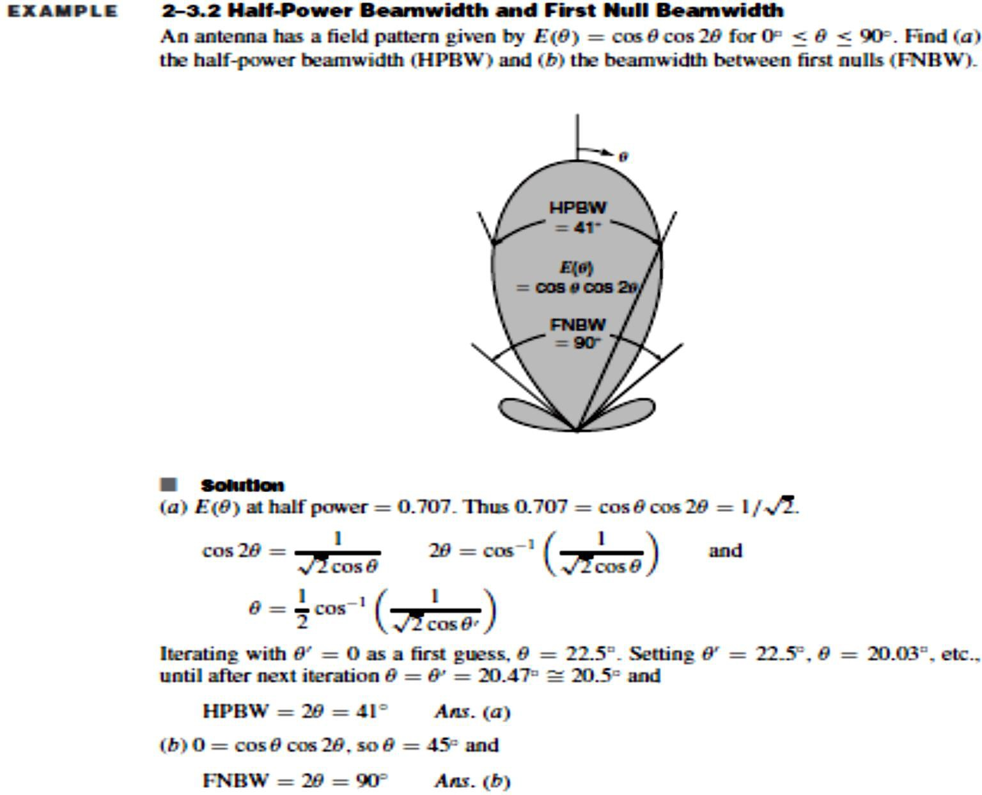
Dept. of Communication Engineering College of Engineering- University of Diyala Lecture No.: 3 part(2)
3rd year Class
Antenna Theory and Design Lec. Jinan N. Shehab
2-1-3- Antenna Field Types:-
- Reactive field:- the portion of the antenna field characterized by standing (stationary) waves which represent stored energy.
- Radiation field:- the portion of the antenna field characterized by radiating (propagating) waves which represent transmitted energy.
2-1-4- Antenna Field Regions:-
the fields around an antenna may be divided into three principle region, , the boundary may be arbitrarily taken to be at a radius:-
𝑅=
2𝐷²
𝜆
Where D = maximum dimension of the antenna, m
λ = wavelength, m
1- Reactive Near Field Region :- the region immediately surrounding the antenna where the reactive field (stored energy – standing waves) is dominant. For most antennas the outer
boundary of this region is :

Slide 5
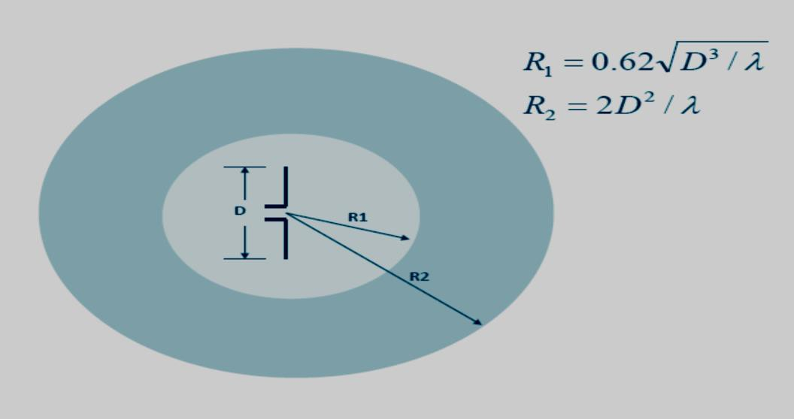
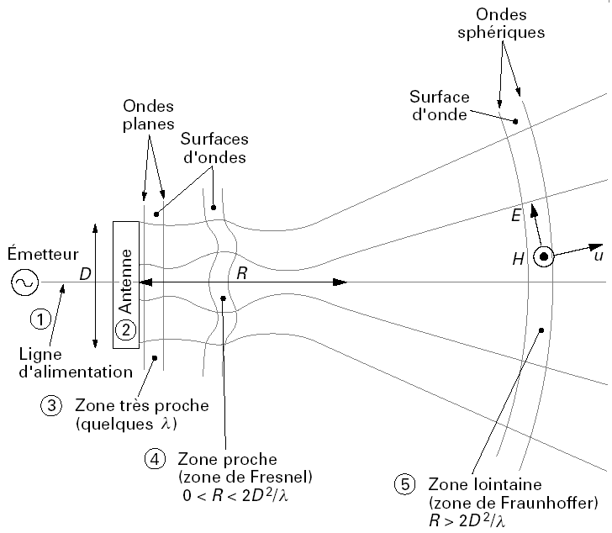
Dept. of Communication Engineering College of Engineering- University of Diyala Lecture No.: 3 part(2)
3rd year Class
Antenna Theory and Design Lec. Jinan N. Shehab
𝑅≤ 0.62√
_{𝐷}3
𝜆
2- Near-Field (Fresnel) Region :- the region between the reactive near- field and the far- field where the radiation fields are dominant and the field distribution is dependent on the distance from the antenna. The inner boundary is taken to be distance:
𝑅≤
2𝐷²
𝜆
3- Far-Field (Fraunhofer) Region :- the region farthest away from the antenna where the field distribution is essentially independent of the distance from the antenna (propagating waves or plane wave). The far field region is commont taken to exist at distances grater than
:-
𝑅>
2𝐷²
�𝑟�� 𝑡ℎ� 𝑎�𝑡���𝑎
𝜆
Spherical waves
Wave
Plane waves
surfaces
Wave surfaces
Emitter
Feeding line
Very near zone
Near field zone (Fresnel)
Far field zone (Fraunhoffer)

Slide 6
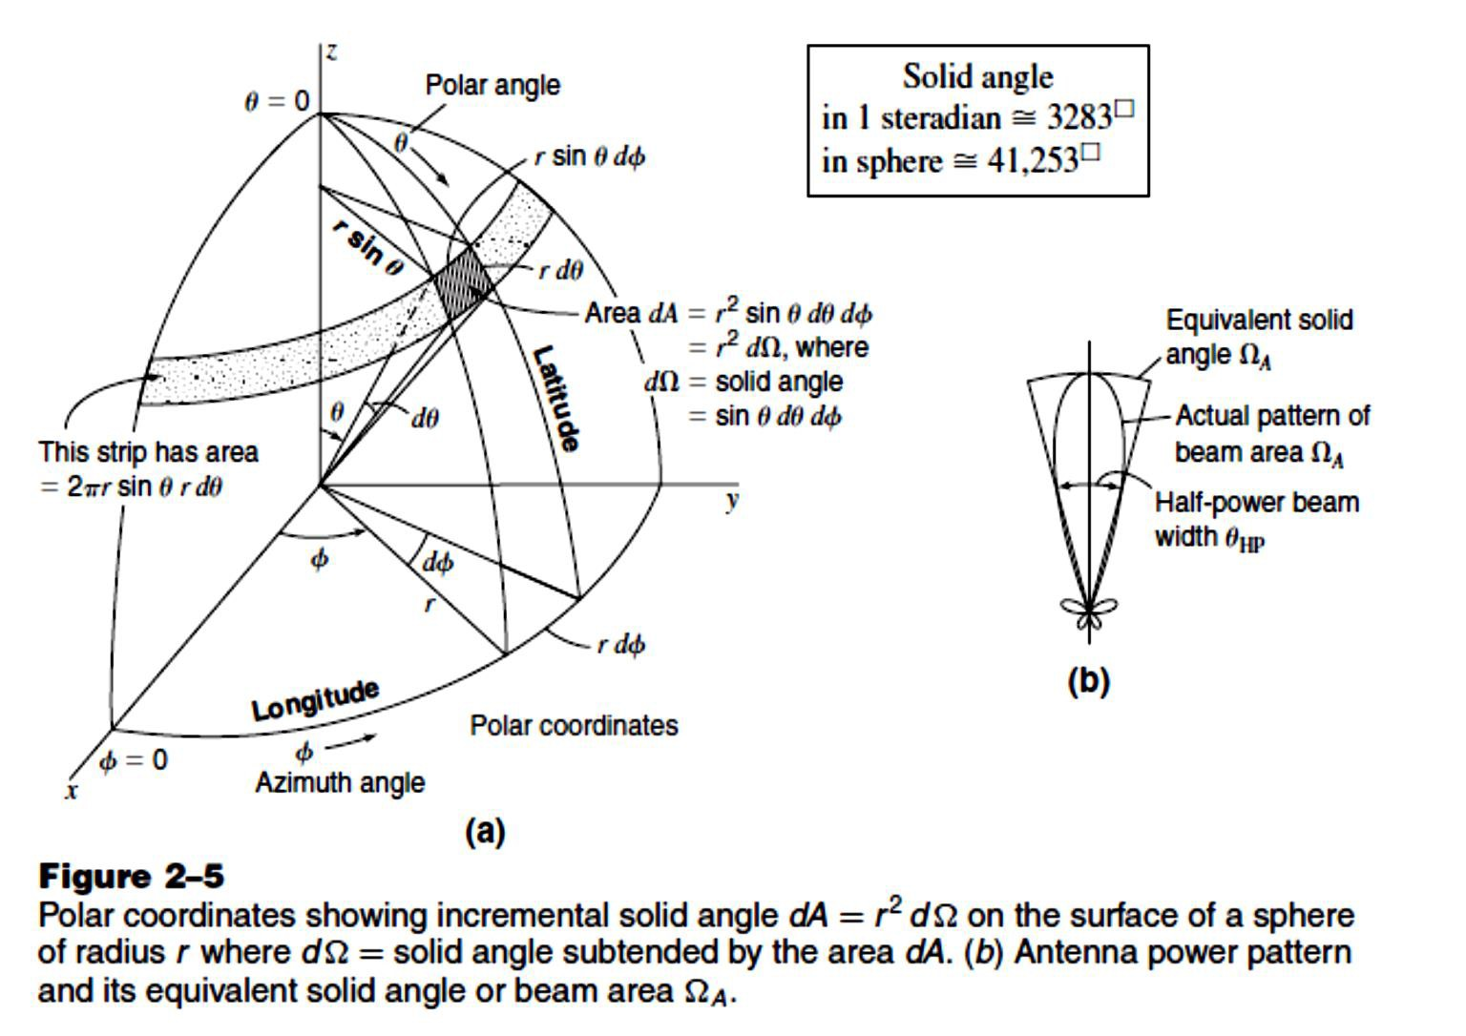
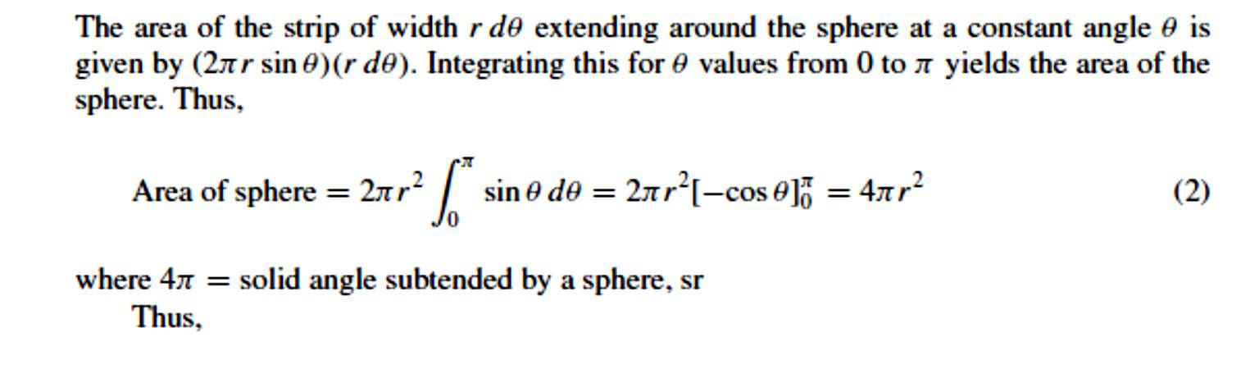
Dept. of Communication Engineering College of Engineering- University of Diyala Lecture No.: 3 part(2)
3rd year Class
Antenna Theory and Design Lec. Jinan N. Shehab
2-2 Beam Area (Or Beam Solid Angle) ΩA:-
In polar two-dimensional coordinates an incremental area dA on the surface of a sphere is the product of the length r dθ in the θ direction (latitude) and r sin θ dφ in the φ direction (longitude), as shown in Fig.
Thus,
dA = (r dθ)(r sin θ dφ) = r² dΩ (1)
where
dΩ = solid angle expressed in steradians (sr) or square degrees (²)
dΩ = solid angle subtended by the area dA= dA/r²

Slide 7
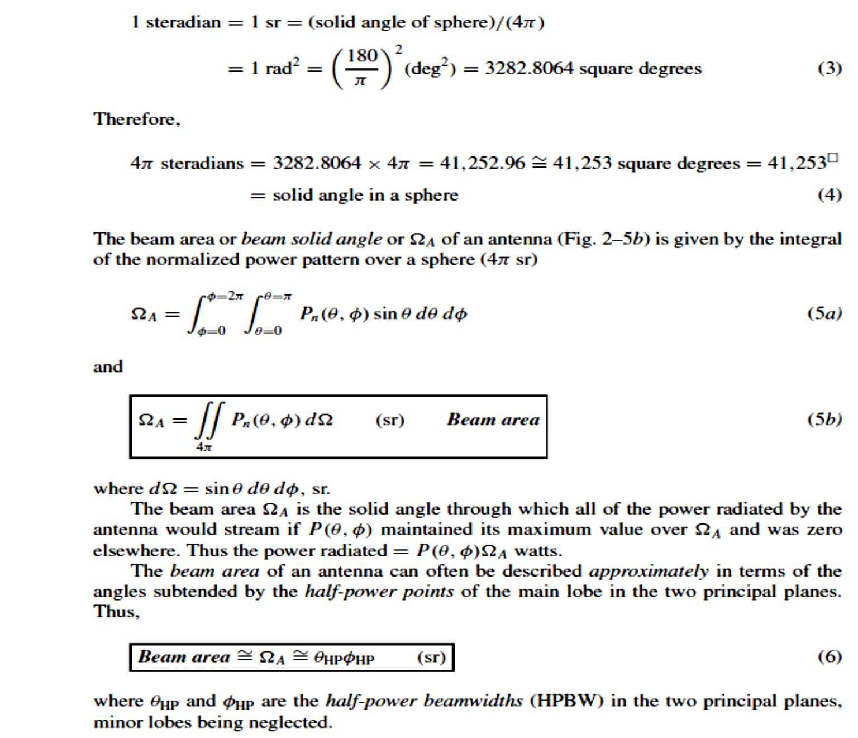
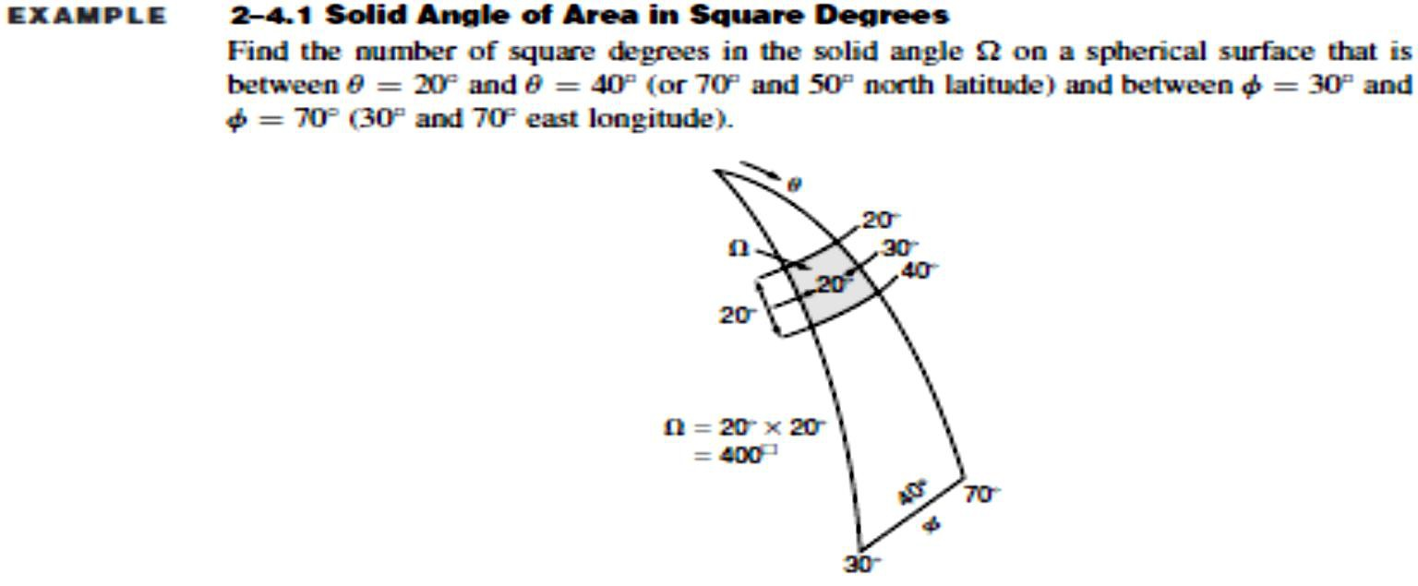
Dept. of Communication Engineering College of Engineering- University of Diyala Lecture No.: 3 part(2)
3rd year Class
Antenna Theory and Design Lec. Jinan N. Shehab

Slide 8
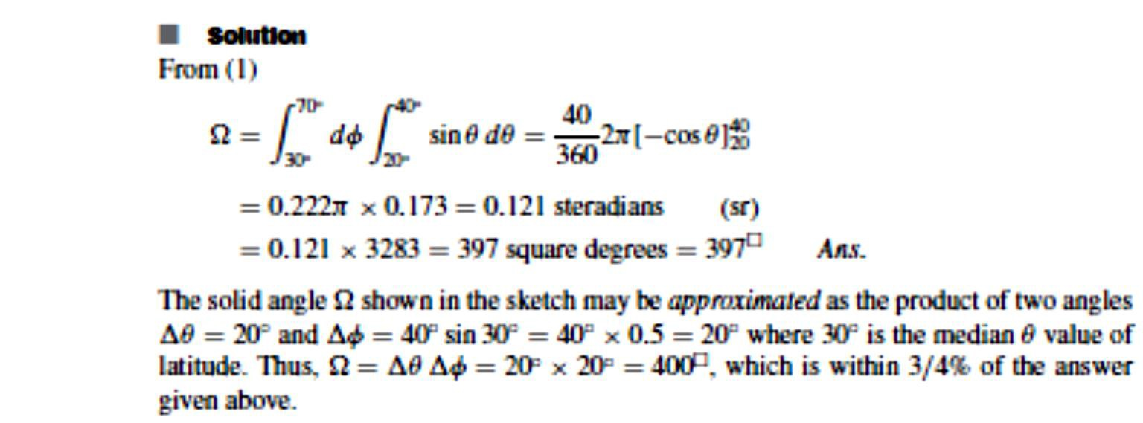
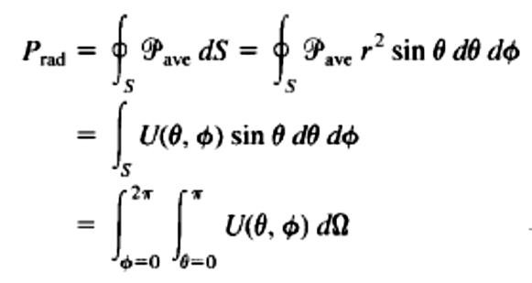
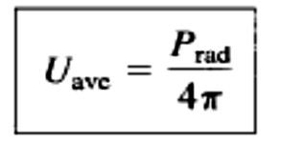
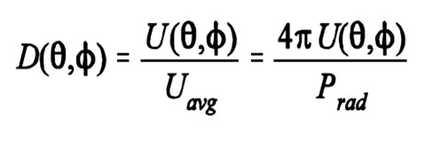
Dept. of Communication Engineering College of Engineering- University of Diyala Lecture No.: 3 part(2)
3rd year Class
Antenna Theory and Design Lec. Jinan N. Shehab
2-3 Radiation Intensity
The power radiated from an antenna per unit solid angle is called the radiation intensity U
(watts per steradian or per square degree). The radiation intensity of an antenna is defined as:-
From equation above, the total average power radiated can be expressed as:-
`2-4 Directivity (D) :-
the ratio of the radiation intensity in a given direction from the antenna to the radiation intensity averaged over all directions.
Or can be defined as:-

Slide 9
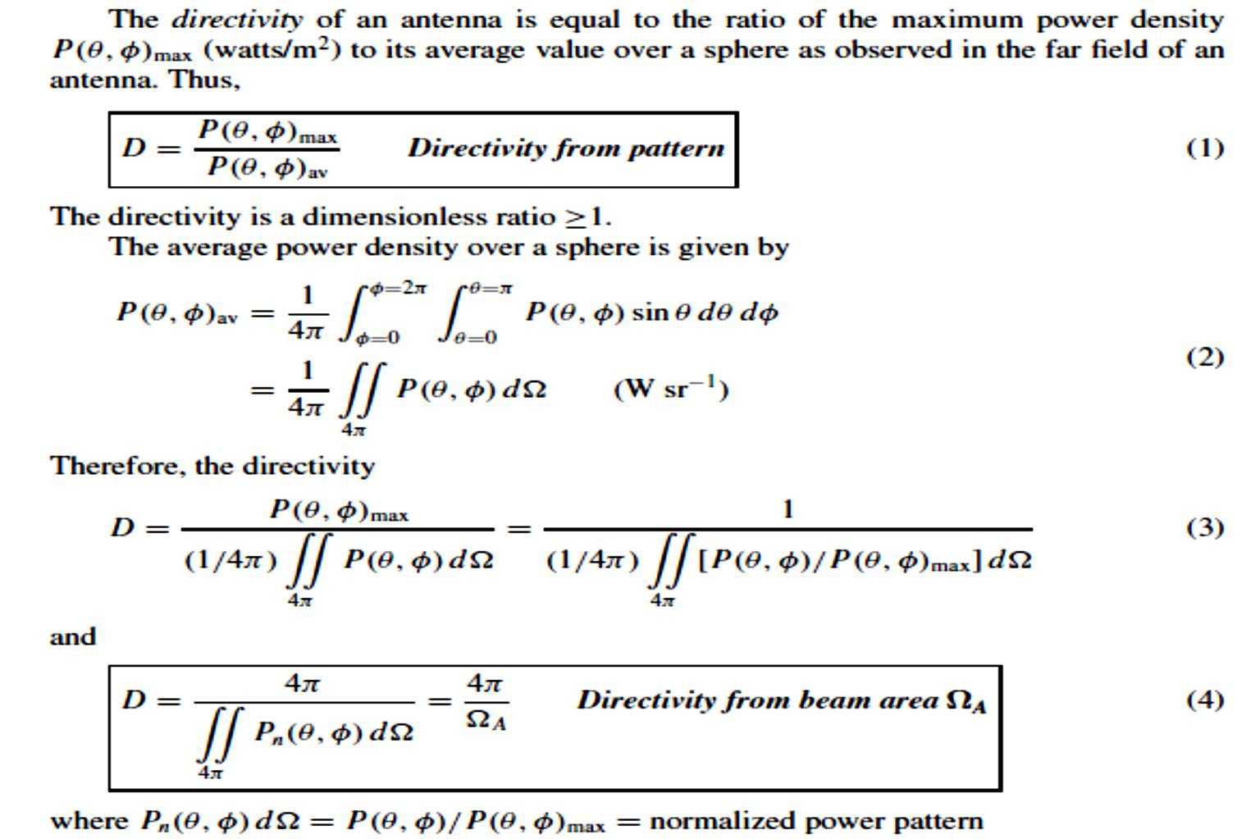
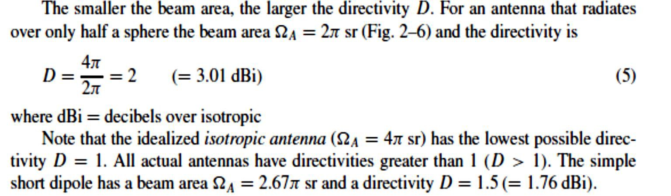
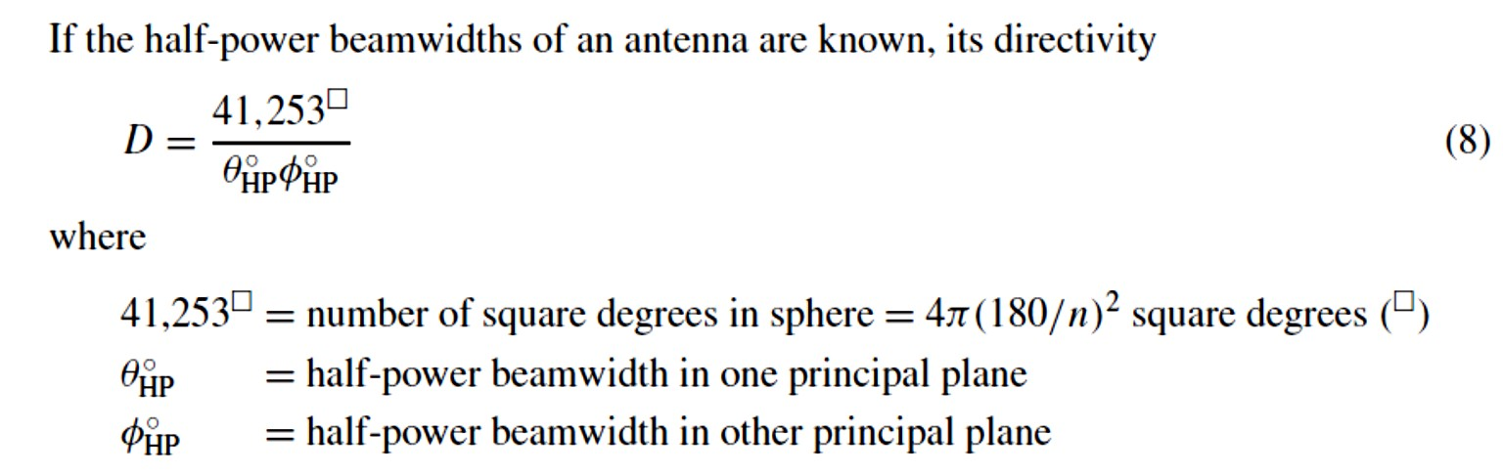
Dept. of Communication Engineering College of Engineering- University of Diyala Lecture No.: 3 part(2)
3rd year Class
Antenna Theory and Design Lec. Jinan N. Shehab

Slide 10
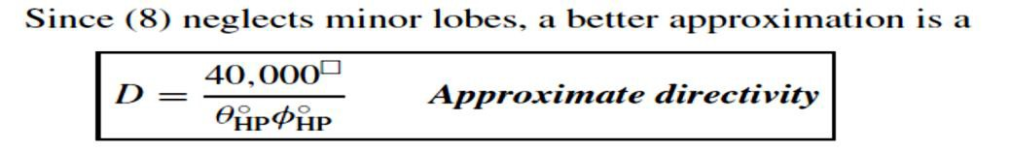
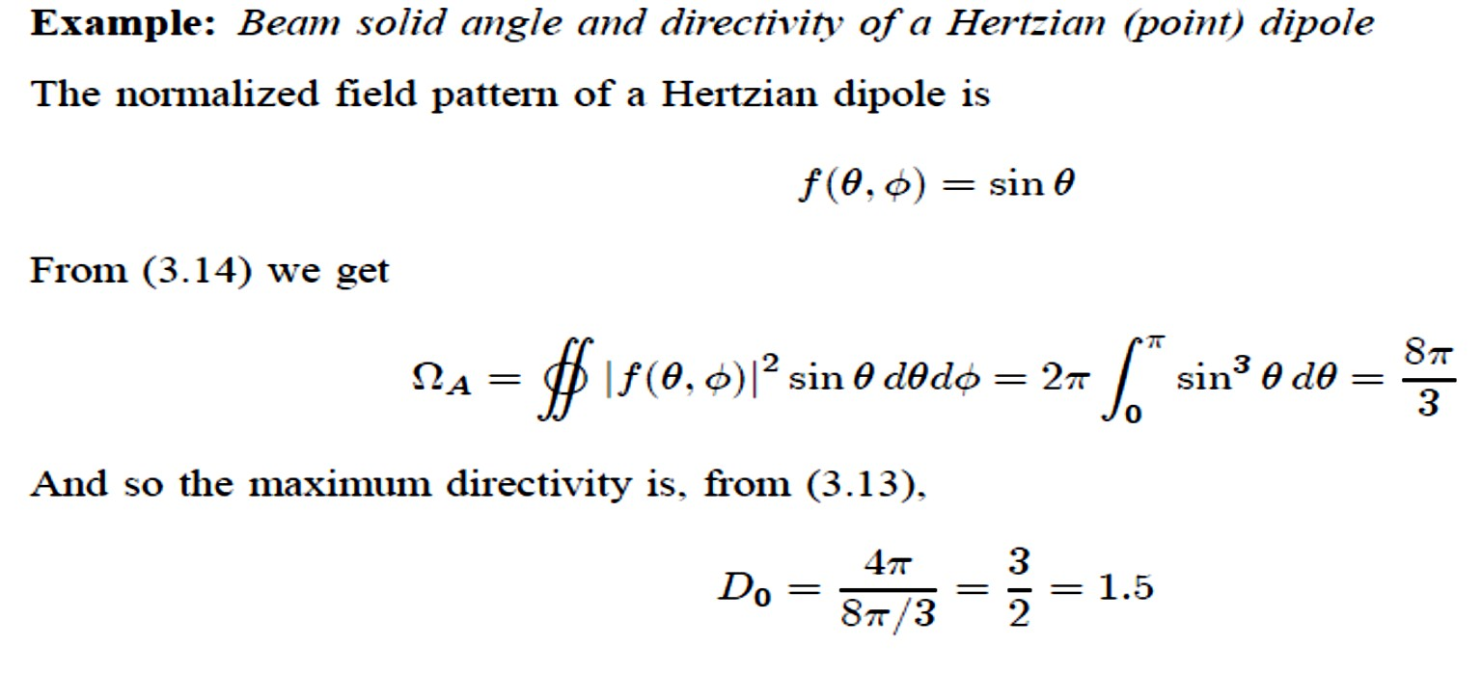
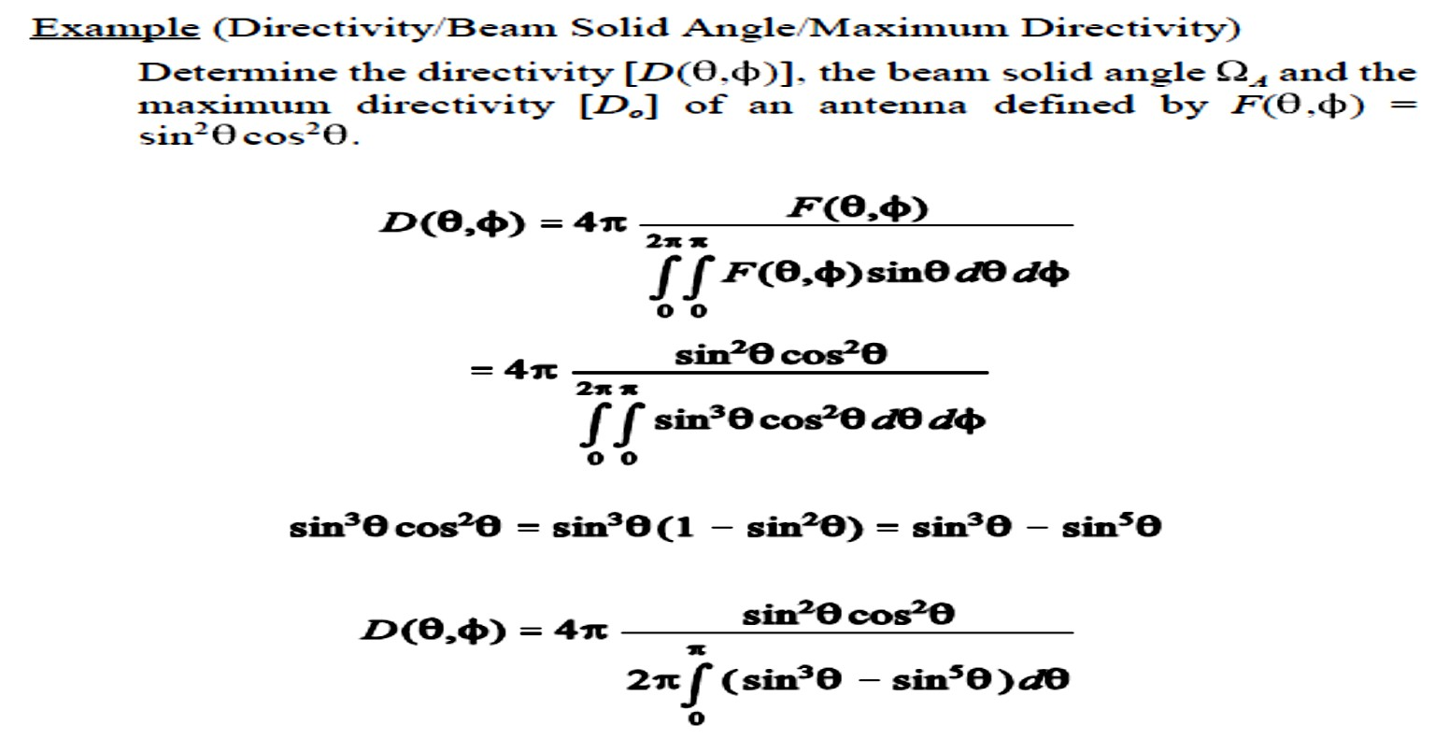
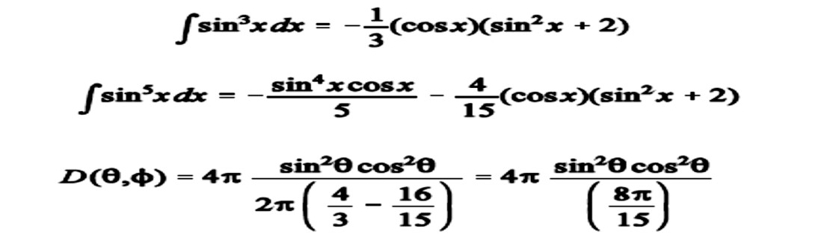
Dept. of Communication Engineering College of Engineering- University of Diyala Lecture No.: 3 part(2)
3rd year Class
Antenna Theory and Design Lec. Jinan N. Shehab

Slide 11
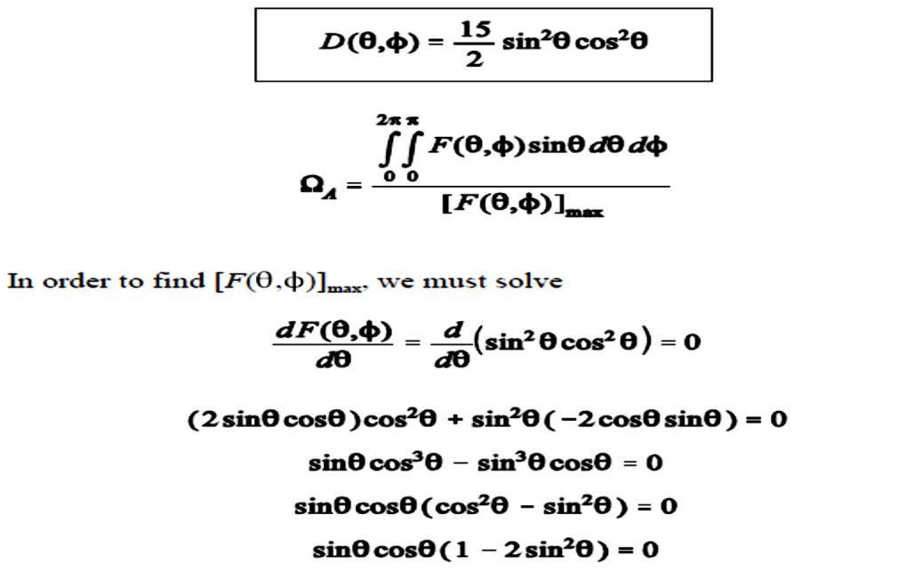
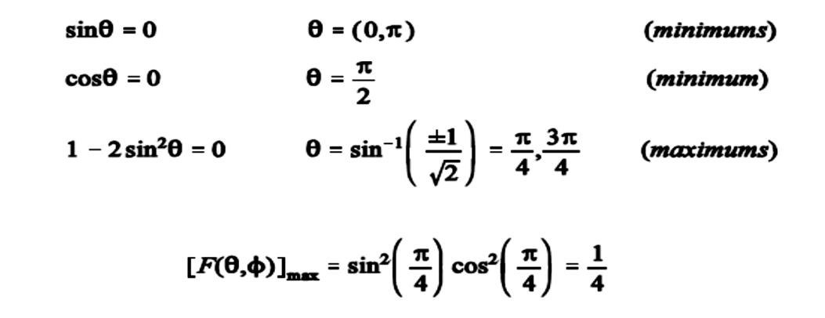
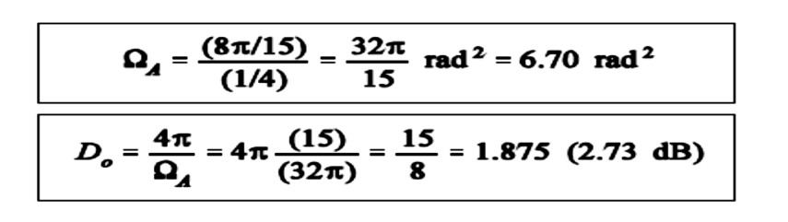
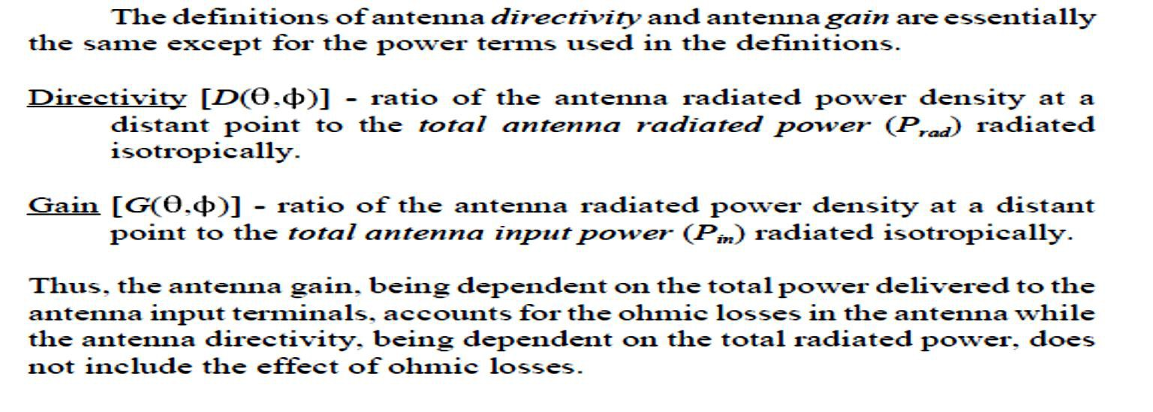
Dept. of Communication Engineering College of Engineering- University of Diyala Lecture No.: 3 part(2)
3rd year Class
Antenna Theory and Design Lec. Jinan N. Shehab
2-5 Gain (G):-

Slide 12
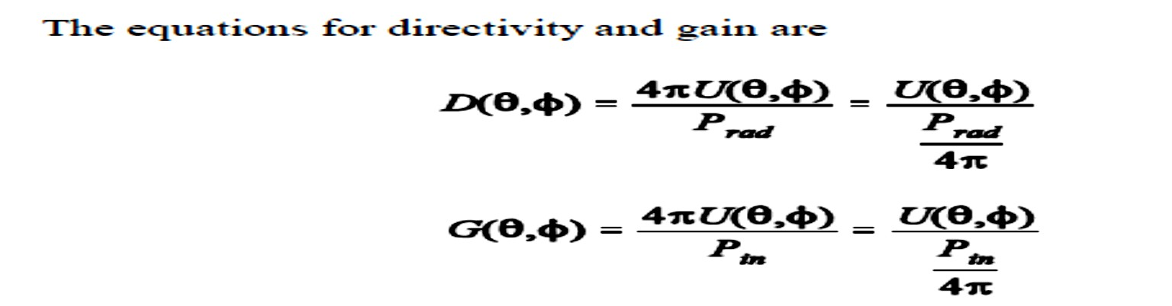
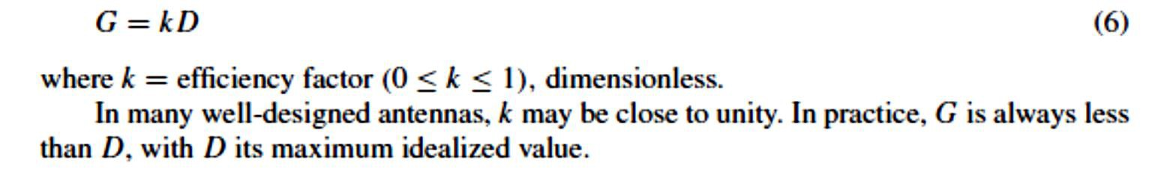
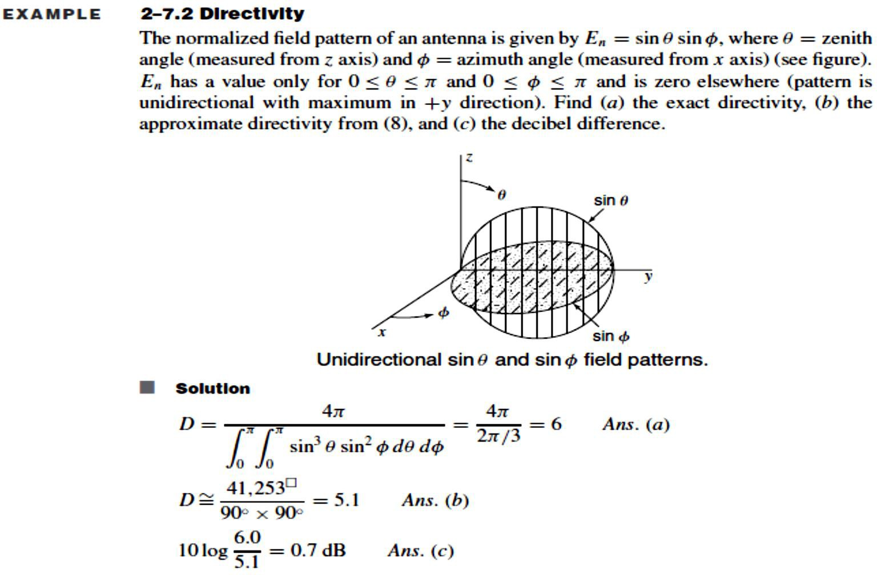
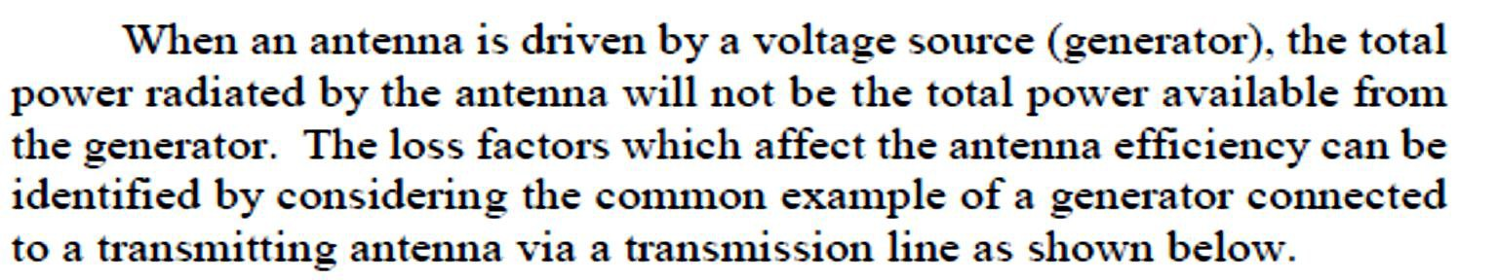
Dept. of Communication Engineering College of Engineering- University of Diyala Lecture No.: 3 part(2)
3rd year Class
Antenna Theory and Design Lec. Jinan N. Shehab
The antenna efficiency facter:-
2-6 Antenna efficiency (e):-

Slide 13
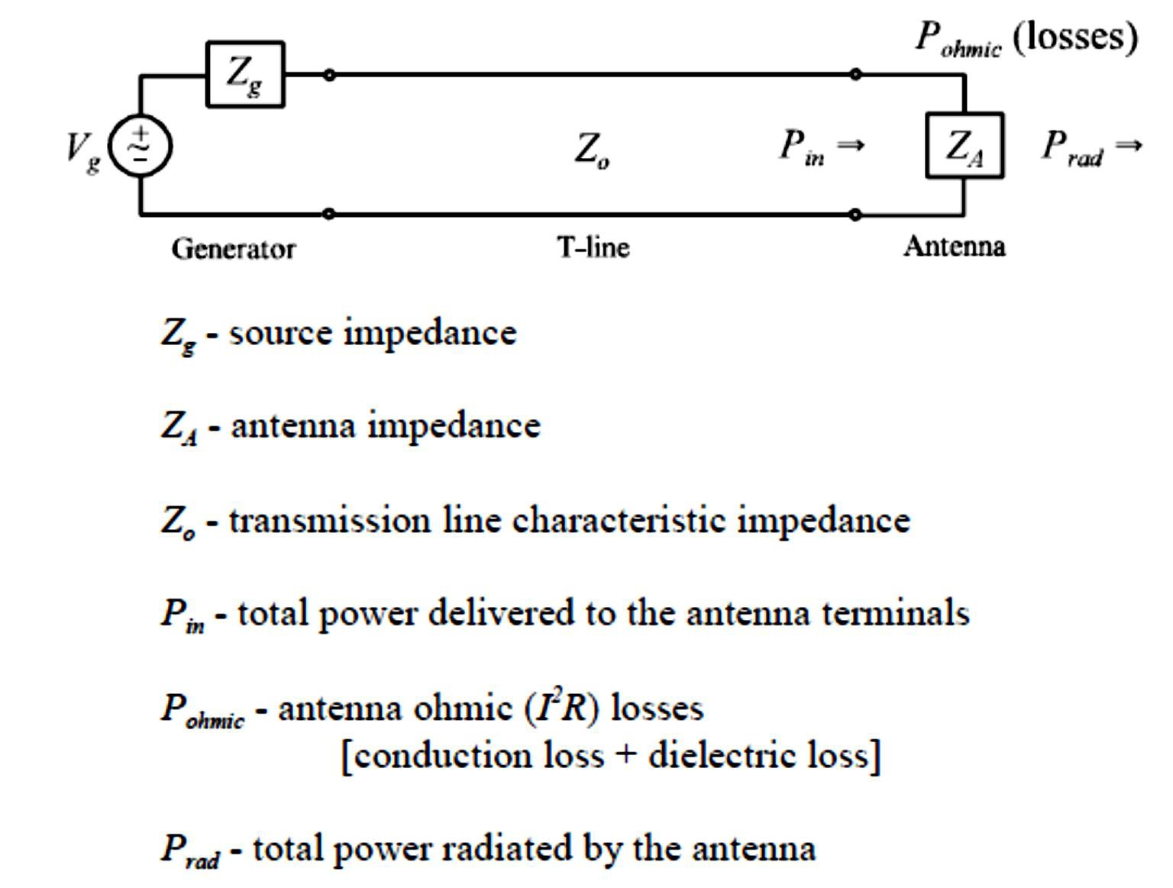

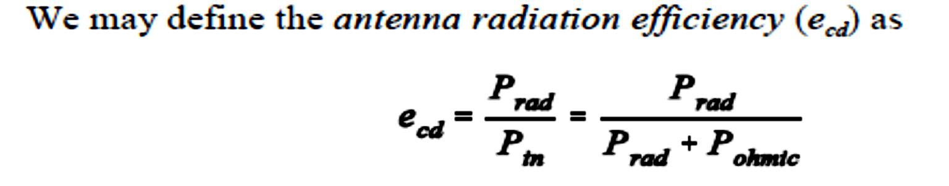
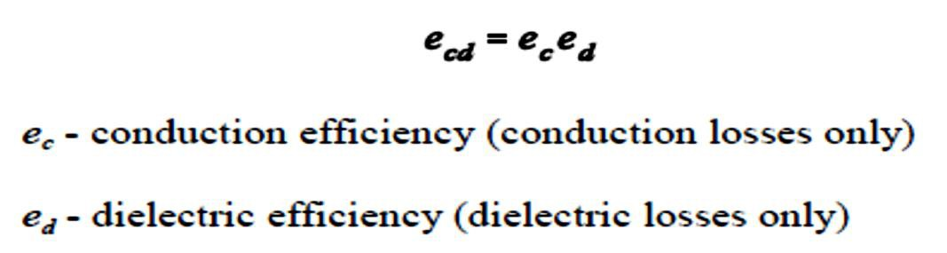
Dept. of Communication Engineering College of Engineering- University of Diyala Lecture No.: 3 part(2)
3rd year Class
Antenna Theory and Design Lec. Jinan N. Shehab

Slide 14
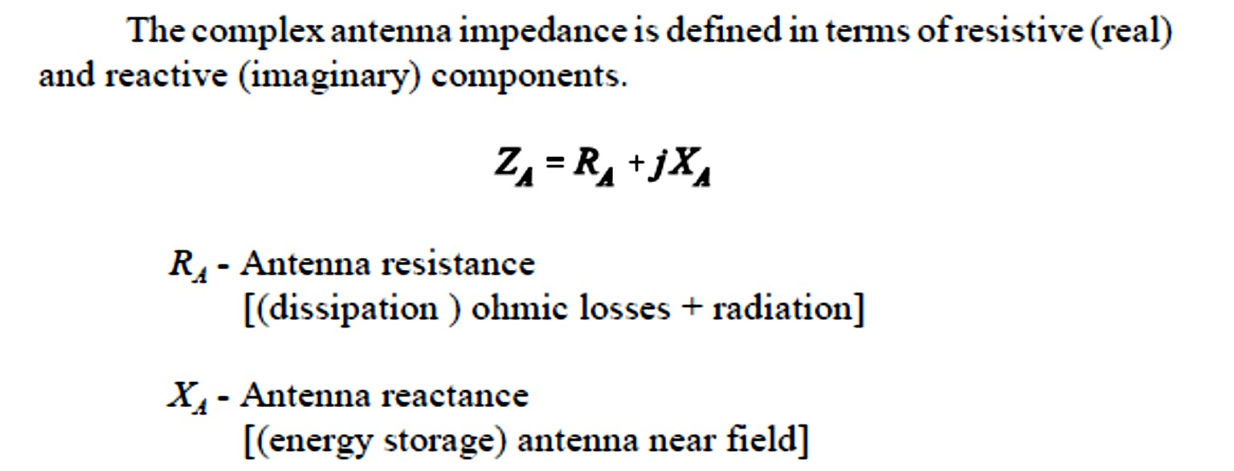
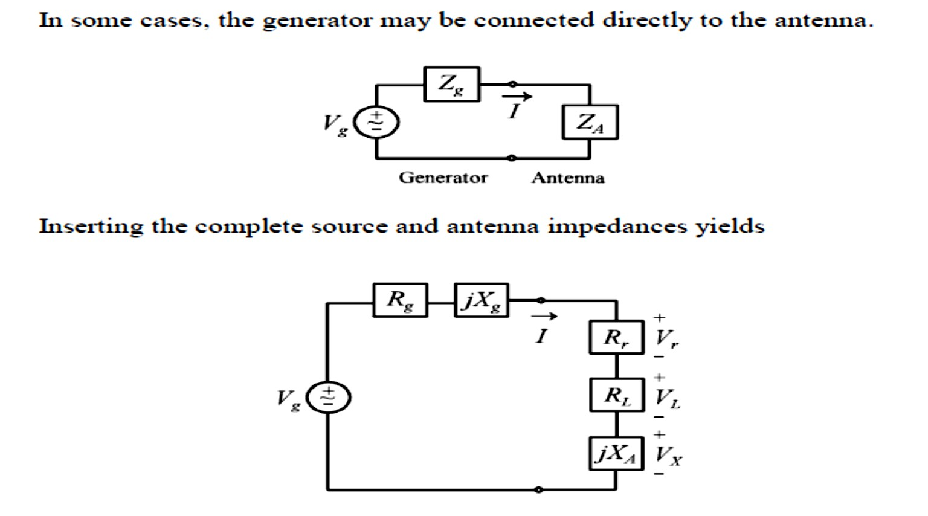
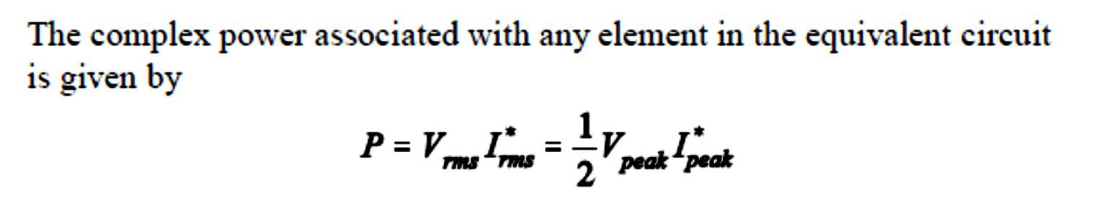

Dept. of Communication Engineering College of Engineering- University of Diyala Lecture No.: 3 part(2)
3rd year Class
Antenna Theory and Design Lec. Jinan N. Shehab
2-7 Antenna Impedance:-

Slide 15
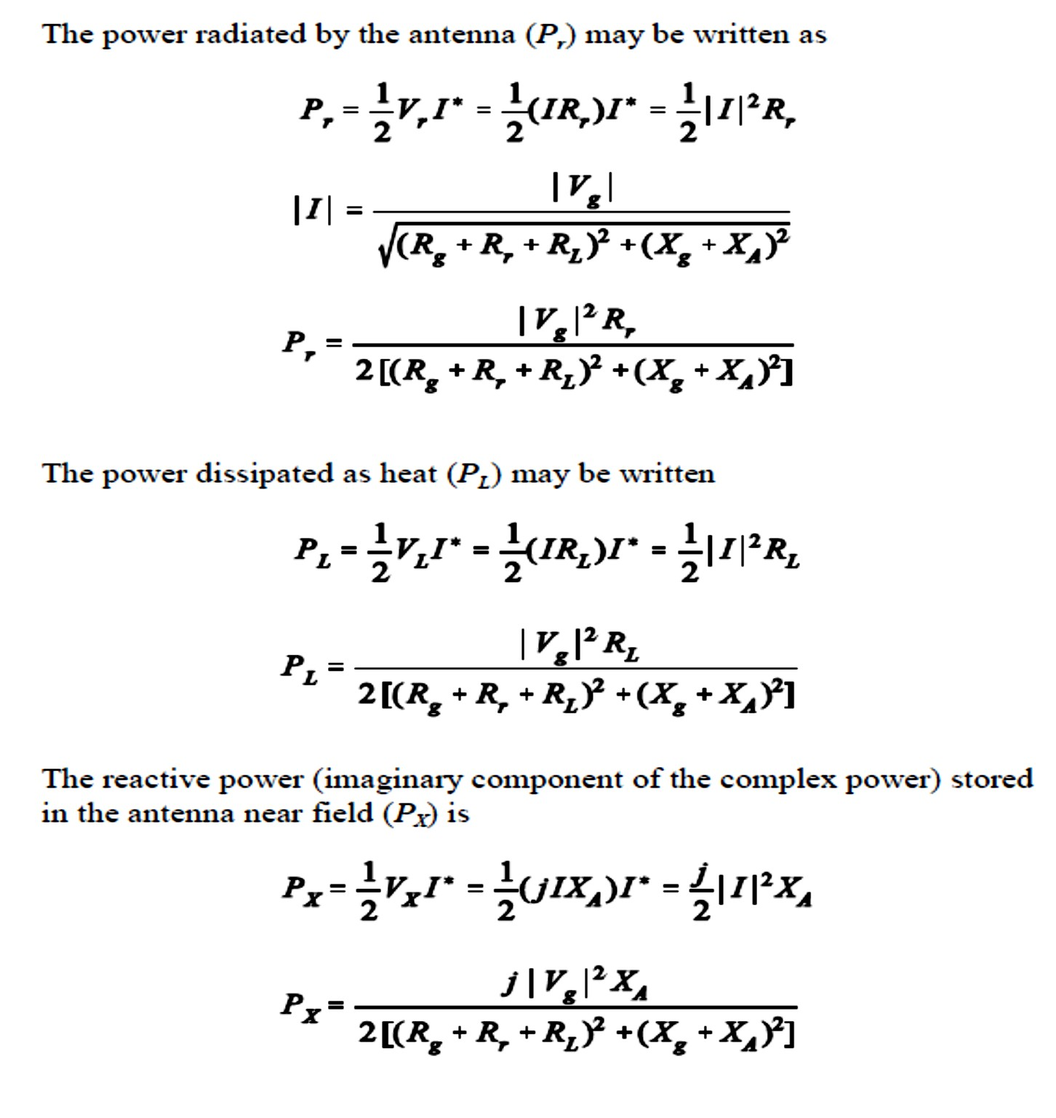
Dept. of Communication Engineering College of Engineering- University of Diyala Lecture No.: 3 part(2)
3rd year Class
Antenna Theory and Design Lec. Jinan N. Shehab

